Slide 1

Submitted From:
MD Dulal Hossain
ID : 213902116
Section : 213 D_5
Course Code : CSE 310
Title : Library Management System .
Submitted To :
MD Solaiman Mia
Assistant Professor,
Department of CSE, GUB.

Slide 2




Outline
Introduction
Implementation
Overview
Objectives
Project Details
Workflow
Source Code
Chapter 1
Chapter 2
Performance
Chapter 3
Chapter 4
Conclusion
Results Analysis
Testing
Discussion
Limitations
Future Work
References

Slide 3
Outline
Introduction
Implementation
Overview
Objectives
Project Details
Workflow
Source Code
Chapter 1
Chapter 2
Performance
Chapter 3
Chapter 4
Conclusion
Results Analysis
Testing
Discussion
Limitations
Future Work
References

Slide 4
Outline
Introduction
Implementation
Overview
Objectives
Project Details
Workflow
Source Code
Chapter 1
Chapter 2
Performance
Chapter 3
Chapter 4
Conclusion
Results Analysis
Testing
Discussion
Limitations
Future Work
References

Slide 5
Outline
Introduction
Implementation
Overview
Objectives
Project Details
Workflow
Source Code
Chapter 1
Chapter 2
Performance
Chapter 3
Chapter 4
Conclusion
Results Analysis
Testing
Discussion
Limitations
Future Work
References

Slide 6
Outline
Introduction
Implementation
Overview
Objectives
Project Details
Workflow
Source Code
Chapter 1
Chapter 2
Performance
Chapter 3
Chapter 4
Conclusion
Results Analysis
Testing
Discussion
Limitations
Future Work
References

Slide 7
Outline
Introduction
Implementation
Overview
Objectives
Project Details
Workflow
Source Code
Chapter 1
Chapter 2
Performance
Chapter 3
Chapter 4
Conclusion
Results Analysis
Testing
Discussion
Limitations
Future Work
References

Slide 8
Introduction
Overview
Objective
This library management system prioritizes user-friendliness, facilitating efficient management of book records. It focuses on seamless addition, finding, editing, and removal of entries, maintaining organized categories, titles, and authors. Clear menus and intuitive prompts enhance ease of use.
This Bash script, conceived by Dulal, facilitates book record management through functions for adding, finding, editing, and removing entries. It boasts error handling, confirmation prompts, and a user-friendly menu interface.

Slide 9
Implementation
Project Details
Workflow
Source Code
Command-line Library Management System efficiently organizes book records with user-friendly menus. It offers functions for adding, searching, editing, and removing entries, ensuring practicality for individuals and small libraries.
The structured workflow of this Library Management System includes options for adding, finding, editing, removing, and viewing books, ensuring efficient management and user-friendly interactions.
Explain this parts for better understand.

Slide 10

Source Code
Step 6
Step 2
Step 5
Step 4
Step 3
Step 1

Slide 11
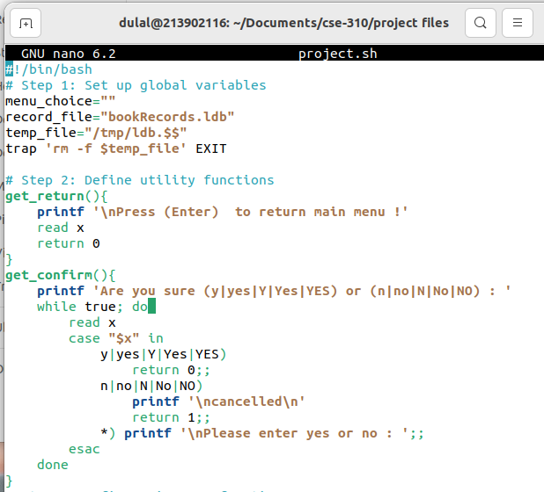
Global – Get Confirm
Step 6
Step 4
Step 2
Step 5
Step 3
Step 1
Figure 2.1: Global & Get – Confirm .

Slide 12
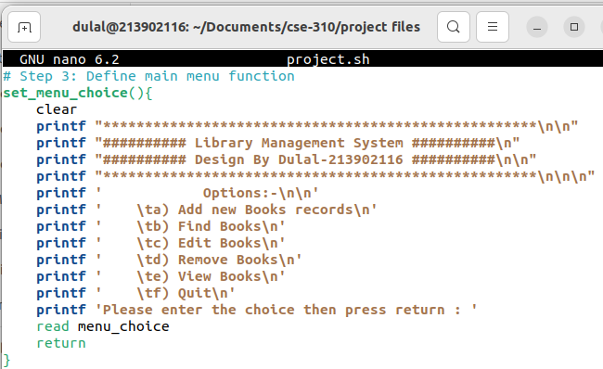
User Interface
Step 6
Step 2
Step 5
Step 4
Step 3
Step 1
Figure 2.2: User Interface

Slide 13
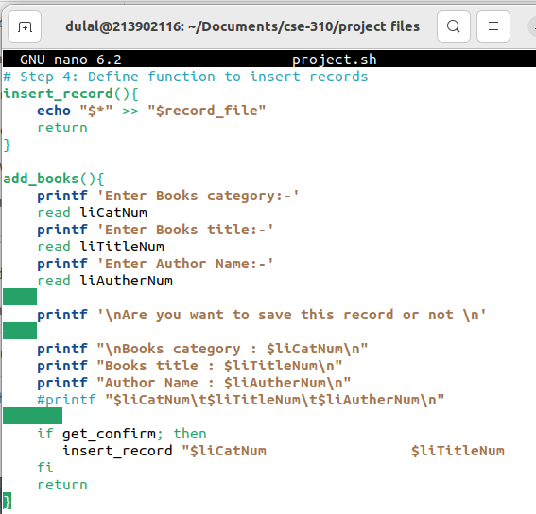
Insert Books
Step 6
Step 2
Step 5
Step 4
Step 3
Step 1
Figure 2.3: Insert Books.

Slide 14
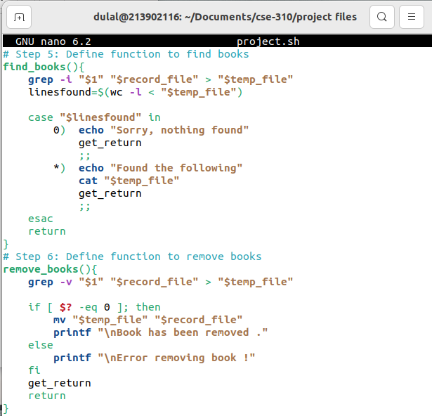
Find – Remove Books
Step 6
Step 2
Step 5
Step 4
Step 3
Step 1
Figure 2.4: Find & Remove –Books.

Slide 15
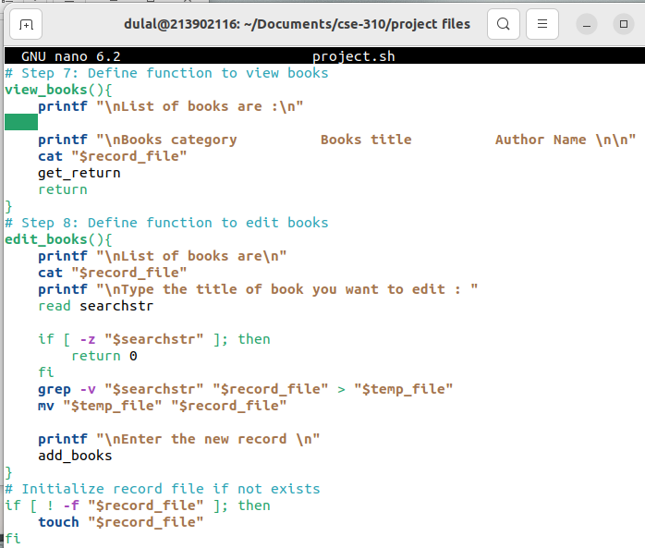
View – Edit Books
Step 6
Step 5
Step 2
Step 4
Step 3
Step 1
Figure 2.5: View & Edit -Books.

Slide 16
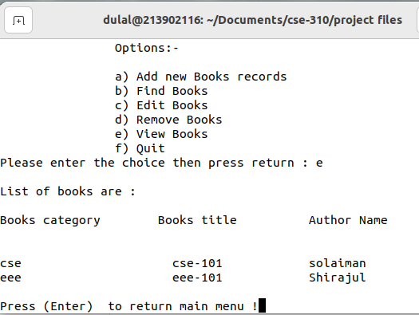
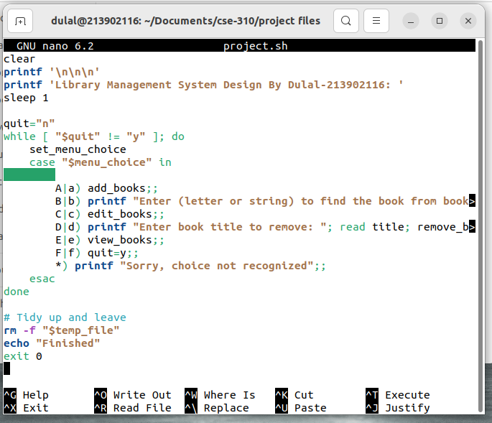
Main Menu
View& Quit
Step 2
Step 6
Step 5
Step 4
Step 23
Step 1
Figure 3.6: View-Books.
Figure 2.6: Main -Menu.

Slide 17
Performance
Result Analysis
Testing
Critical steps in the library management system project include functionality, integration, user acceptance, performance, and security testing. These ensure proper feature implementation, seamless component interaction, user satisfaction, efficient performance, and robust security measures, enhancing overall system reliability and functionality.
Dulal-213902116's Library Management System efficiently handles book records, facilitating effortless addition, search, editing, and removal. Its intuitive interface ensures smooth navigation, enhancing library operations. Meticulous implementation ensures comprehensive resource management, benefiting both librarians and patrons .
Explain this parts for better understand.

Slide 18
Testing
View& Quit
Add Book
Remove
Edit Book
Find Book
Menu

Slide 19
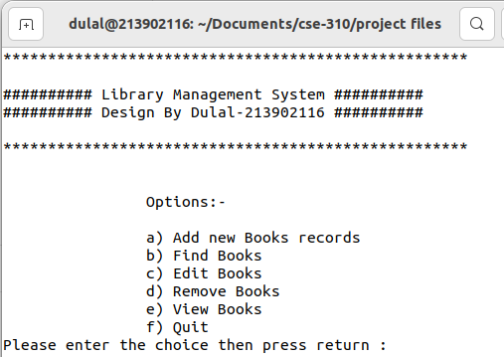
View& Quit
Edit Book
Add Book
Remove
Find Book
Menu
Figure 3.1: User-Interface Part

Slide 20
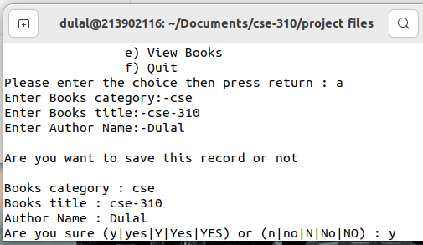
View& Quit
Add Book
Remove
Edit Book
Find Book
Menu
Figure 3.2: Insert new Books

Slide 21
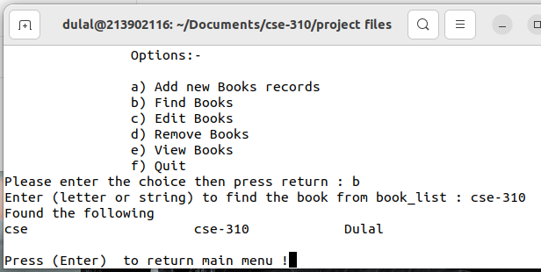
View& Quit
Add Book
Remove
Edit Book
Find Book
Menu
Figure 3.3: Find Books.

Slide 22
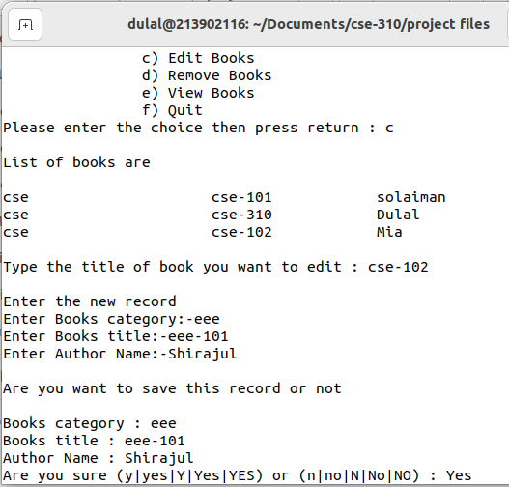
View& Quit
Add Book
Remove
Edit Book
Find Book
Menu
Figure 3.4: Edit-Books

Slide 23
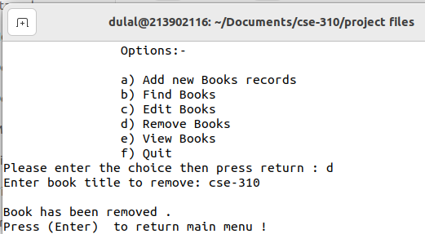
View& Quit
Remove
Add Book
Edit Book
Find Book
Menu
Figure 3.5: Remove-Books.

Slide 24
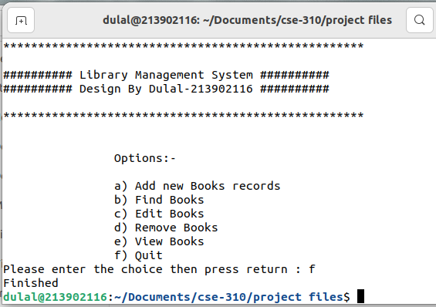
View& Quit
Add Book
View& Quit
Remove
Edit Book
Find Book
Menu
Figure 3.6: View-Books.
Figure 3.6: View-Books.
Figure 3.7: Quit.

Slide 25
Conclusion…
Discussion
Limitations
Dulal-213902116's library management system offers a straightforward solution, allowing users to add, find, edit, and remove book entries through a user-friendly command-line interface. It ensures data integrity with confirmation prompts, meeting basic requirements and enhancing user experience for efficient management.
The presented library management system has limitations including scalability issues, single-user interface, inadequate data validation, minimal security measures, and reliance on a command-line interface. Integrating a graphical user interface could enhance usability and address these shortcomings effectively.

Slide 26
Conclusion
Future Work
References
Future enhancements for the library management system include implementing a graphical user interface, multi-user support, advanced search and sorting options, robust data validation, error handling, and integration with external systems, ensuring a comprehensive solution for diverse library needs.
https://www.javatpoint.com/shell-scripting-tutorial
https://www.learnshell.org/
https://www.udemy.com/topic/shell-scripting/
https://www.tutorialspoint.com/unix/shell-scripting.htm
https://www.shellscript.sh/

Slide 27
Thank You
Keep Learning, Keep Grinding

